Slide 1
ENGG1050 - Engineering Design
Group A11 - WEEK 13 Presentation

Slide 2
1. Introduction
Vision: To deliver a functioning RGM and showcase our collaborative and creative capabilities
AGILE Project management; eﬀective leadership and product design (positive values, curiosity, communication, decision making, experimentation and purpose)
‘A11 Attitude!’ Never Give Up, be responsible for all members, always give everyone a go
(Perseverance, Responsibility and Trust)
Result: SYNERGY!

Slide 3
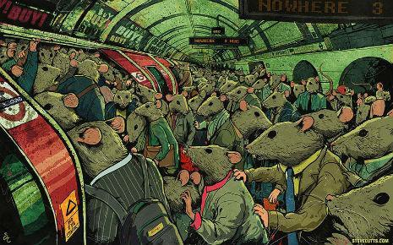

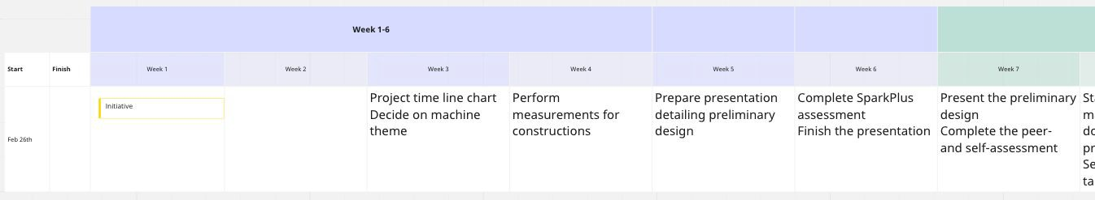
2. Our Client and Timeline
THEME > Problem deﬁnition > Client:
Working University Student, struggling with ﬁnances. Not enough time to make affordable and nutritious meals. Can’t hire a cook and doesn’t have the space. Loses unnecessary funds on food outside.
SOLUTION: RGM designed for making food (in this case it’s BREAKFAST)
Snapshot of our Timeline
TIMELINE: Linear, following the AGILE principle of prioritizing tasks and working
on one at a time.
Easy to read and follow
Efforts were better focused on
one task at a time

Slide 4
3. Design, Reliability and Video-making
Tahsin Bin Sohail

Slide 5
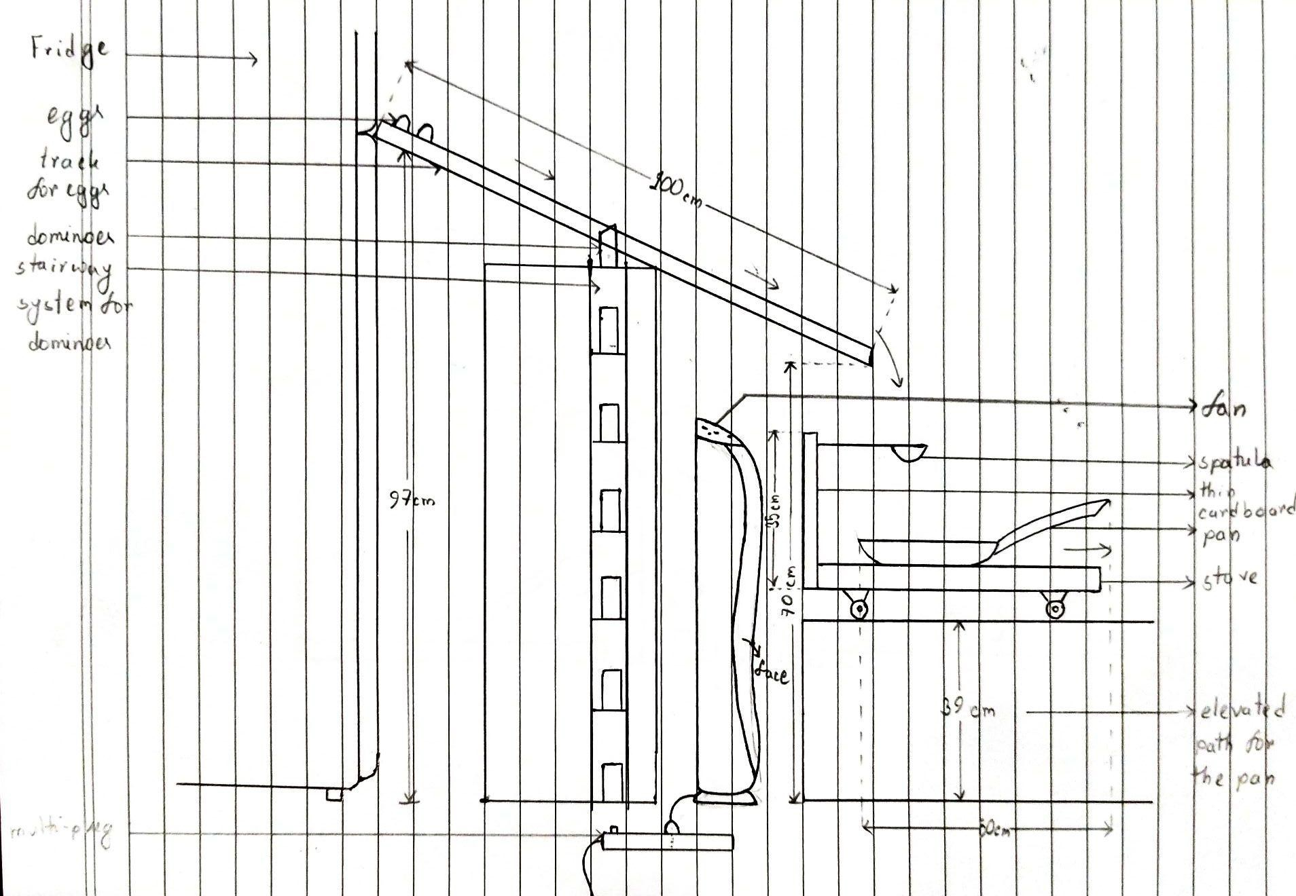
Detailed Design (Events 1-2)

Slide 6
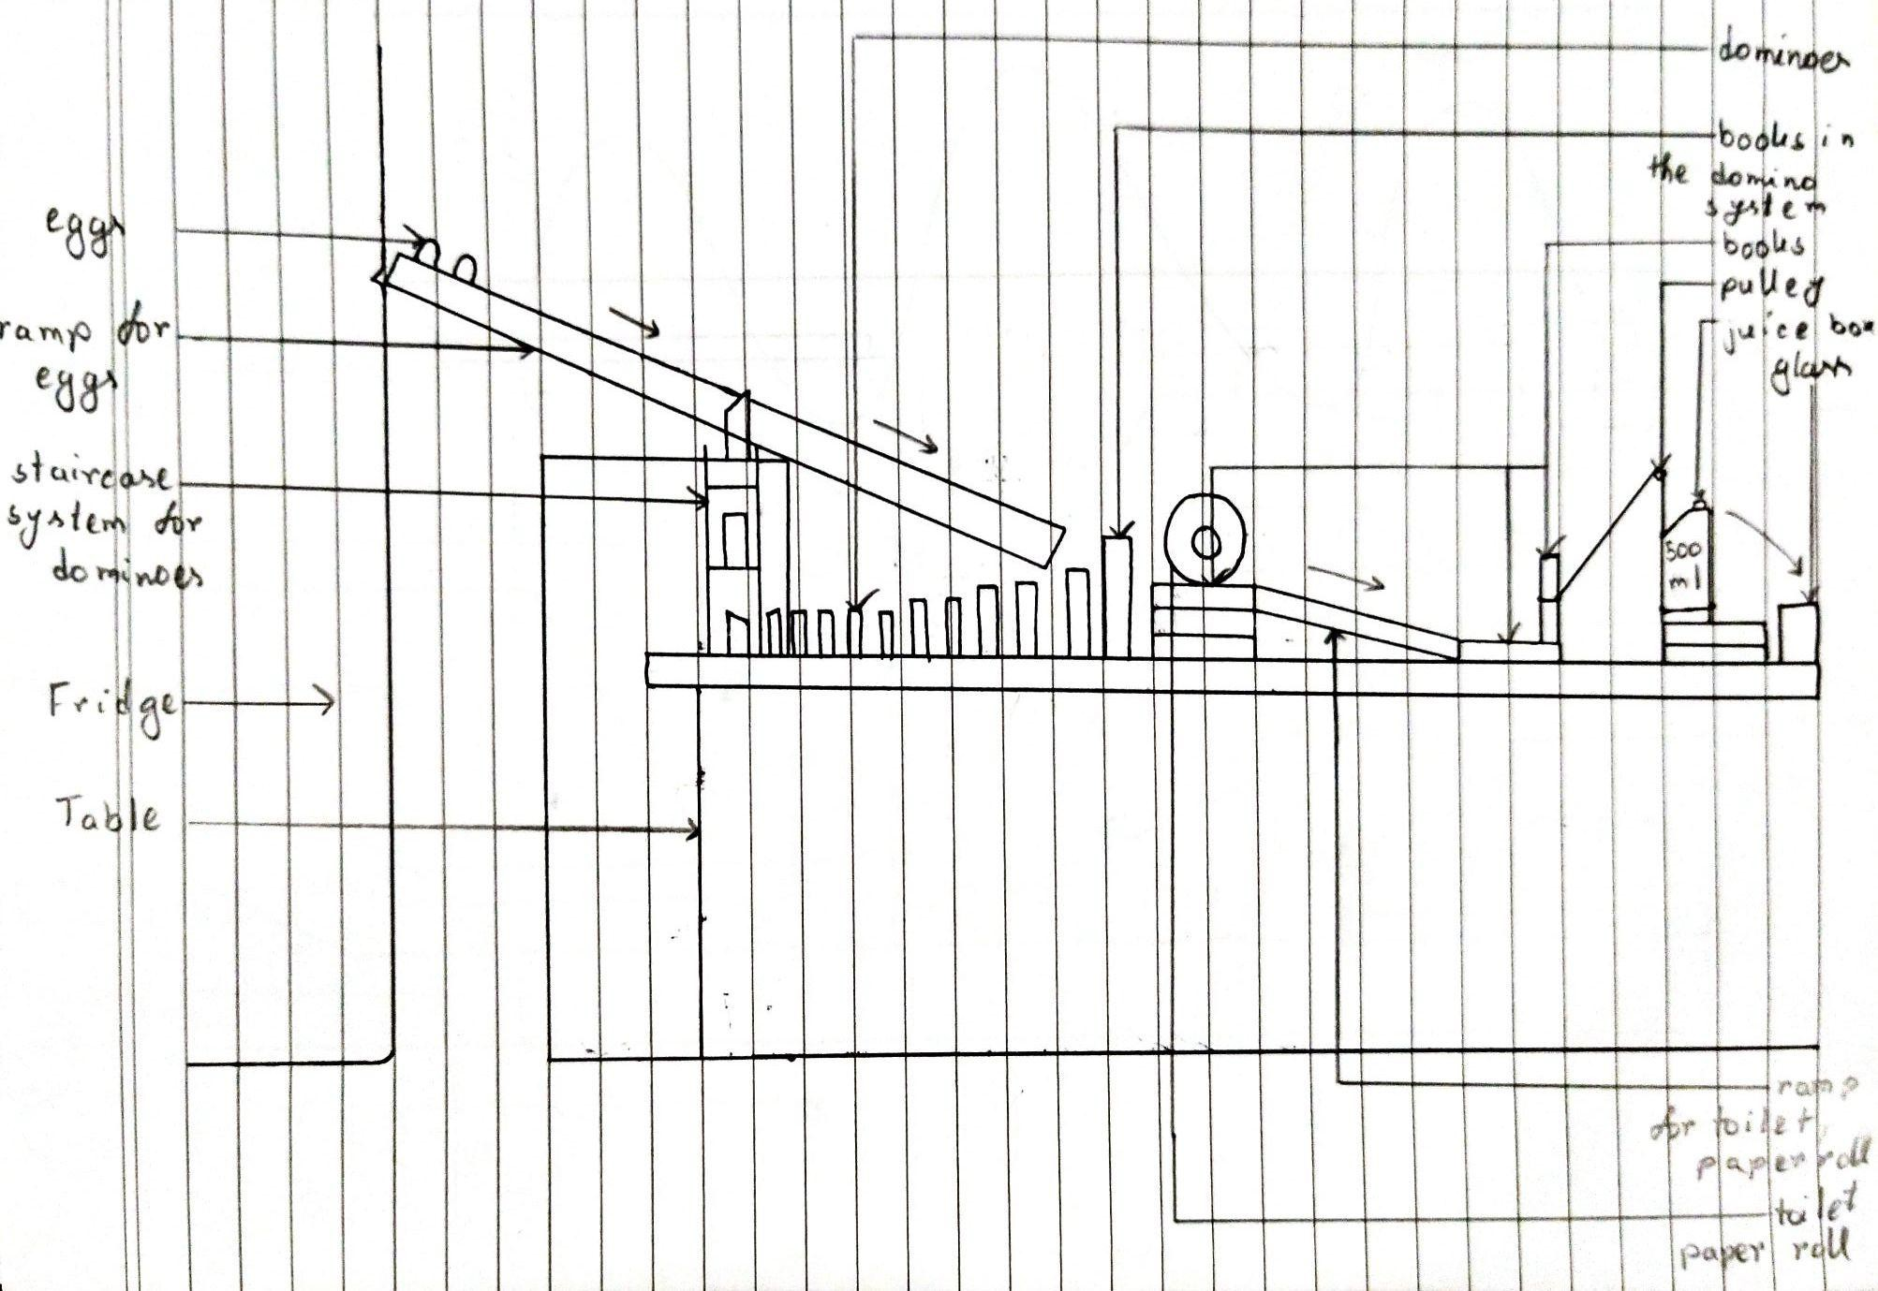
Detailed Design (Events 3-4)

Slide 7
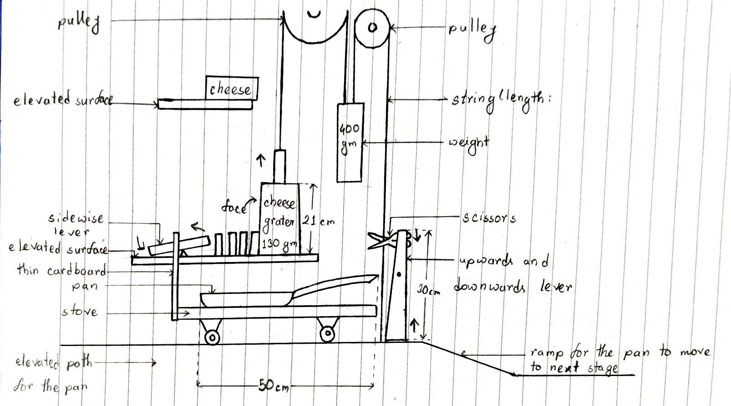
Detailed Design (Events 5-6)

Slide 8
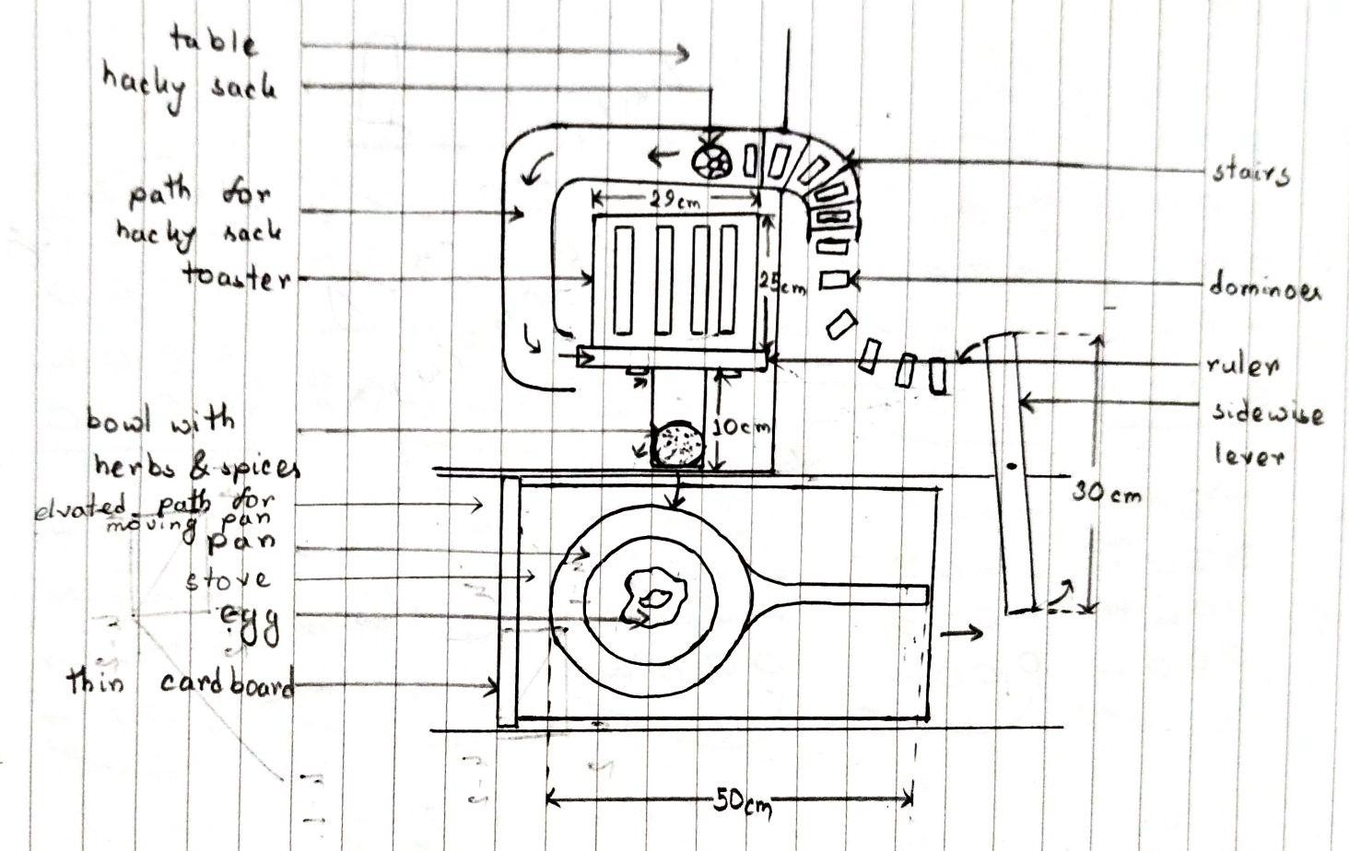
Detailed Design (Events 7-8)

Slide 9
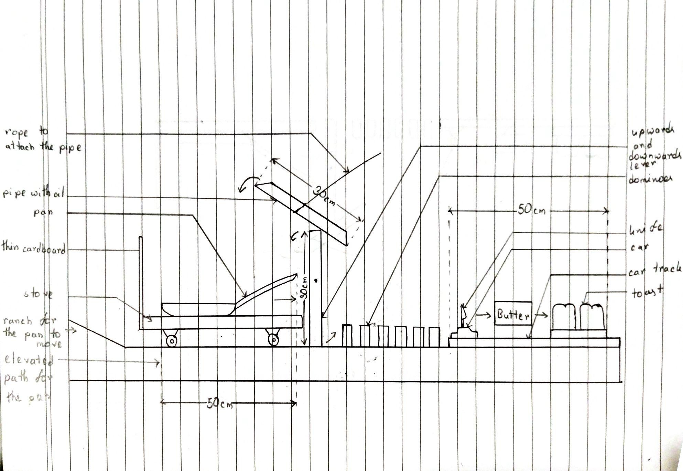
Detailed Design (Events 9-10)

Slide 10
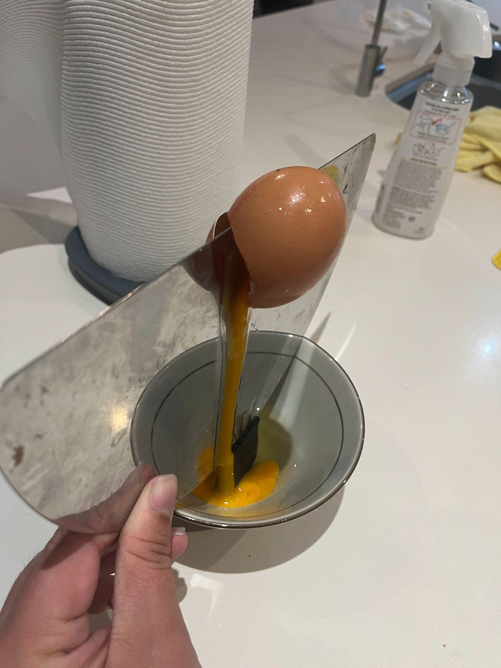
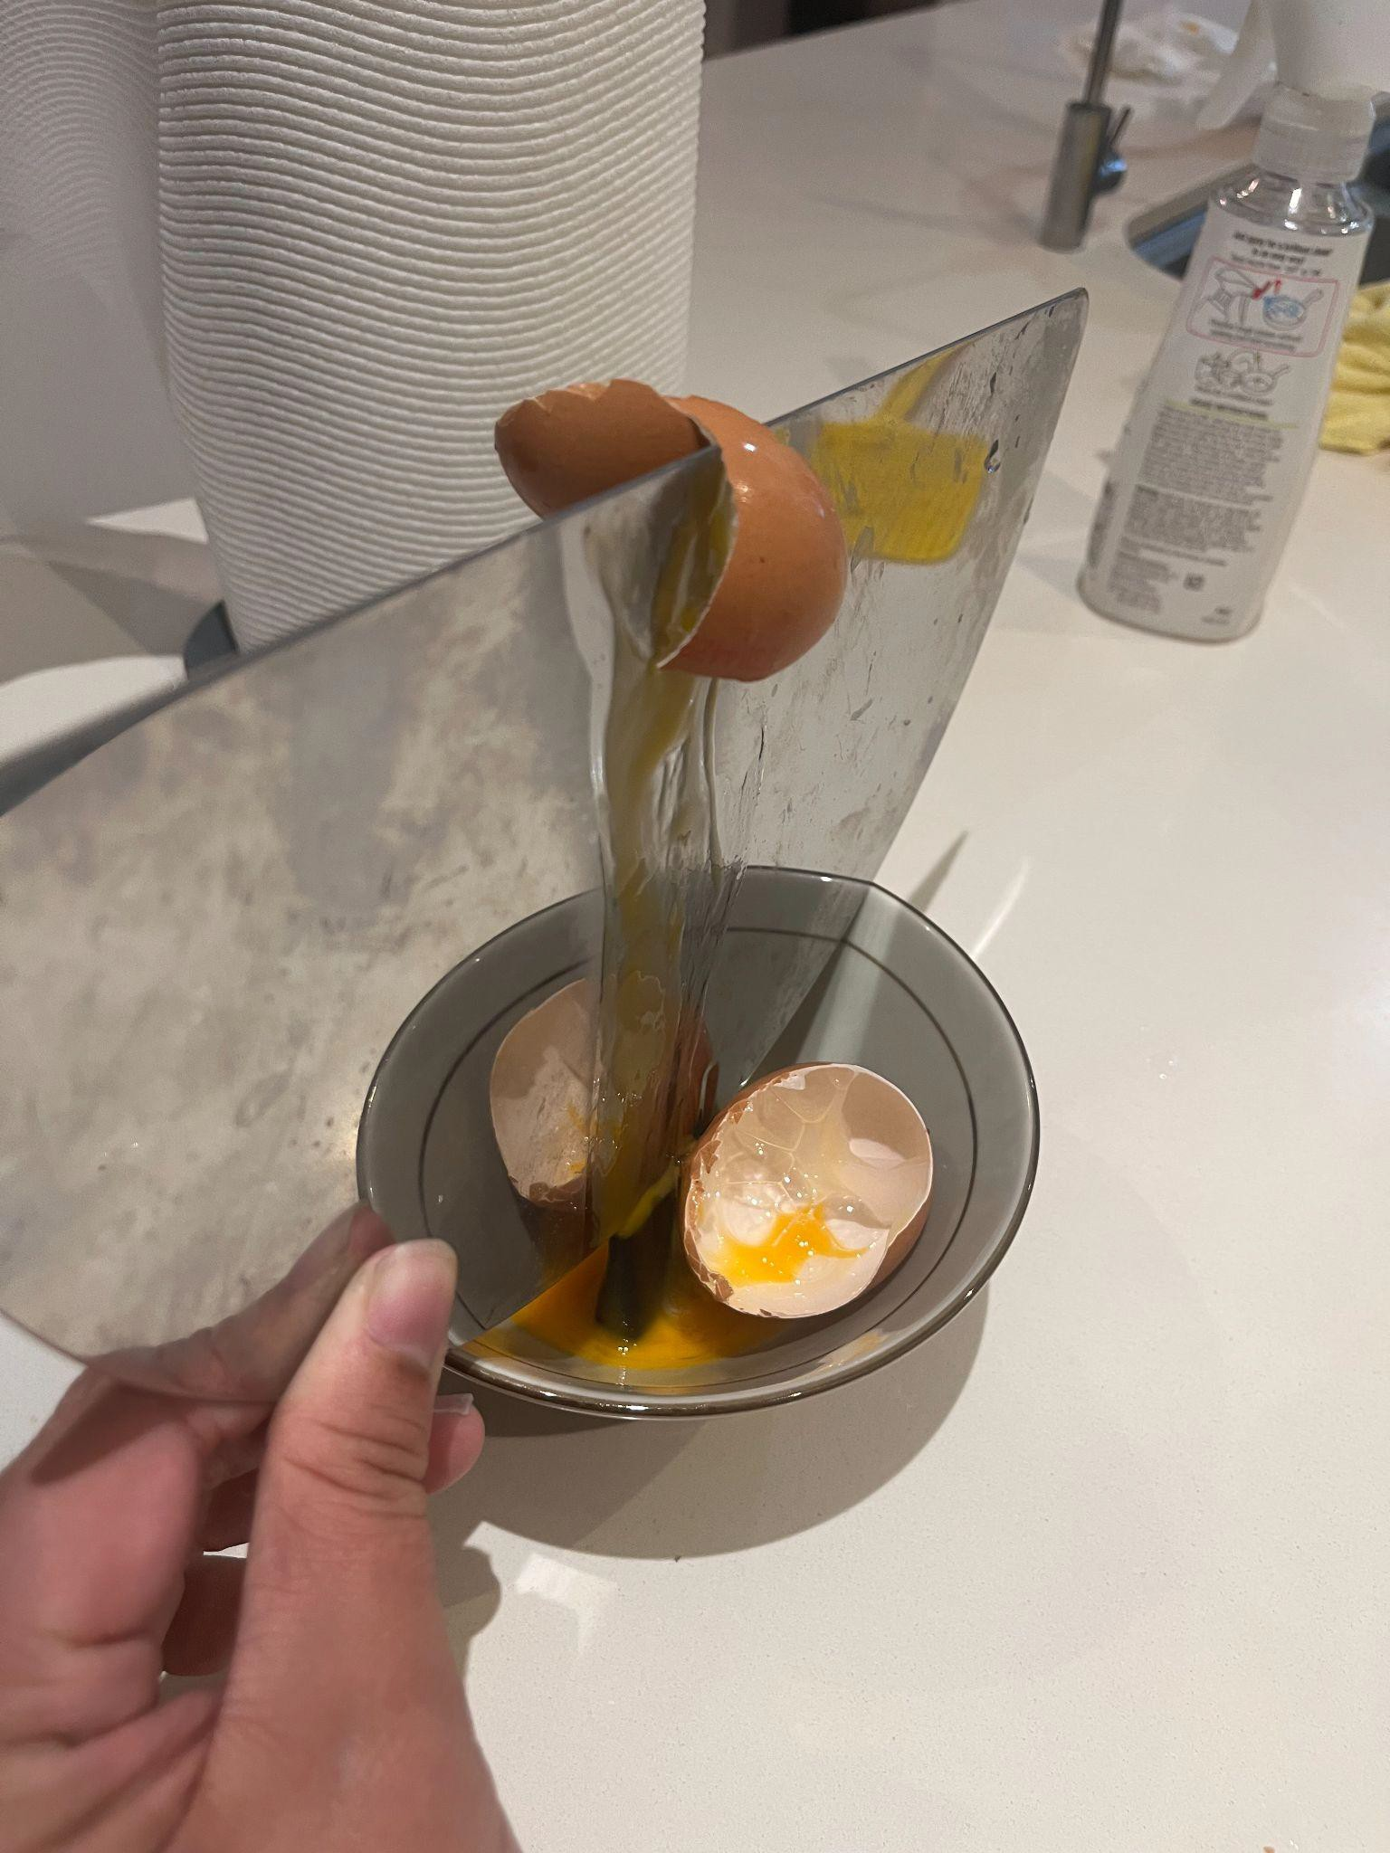
Egg Breaking Test

Slide 11
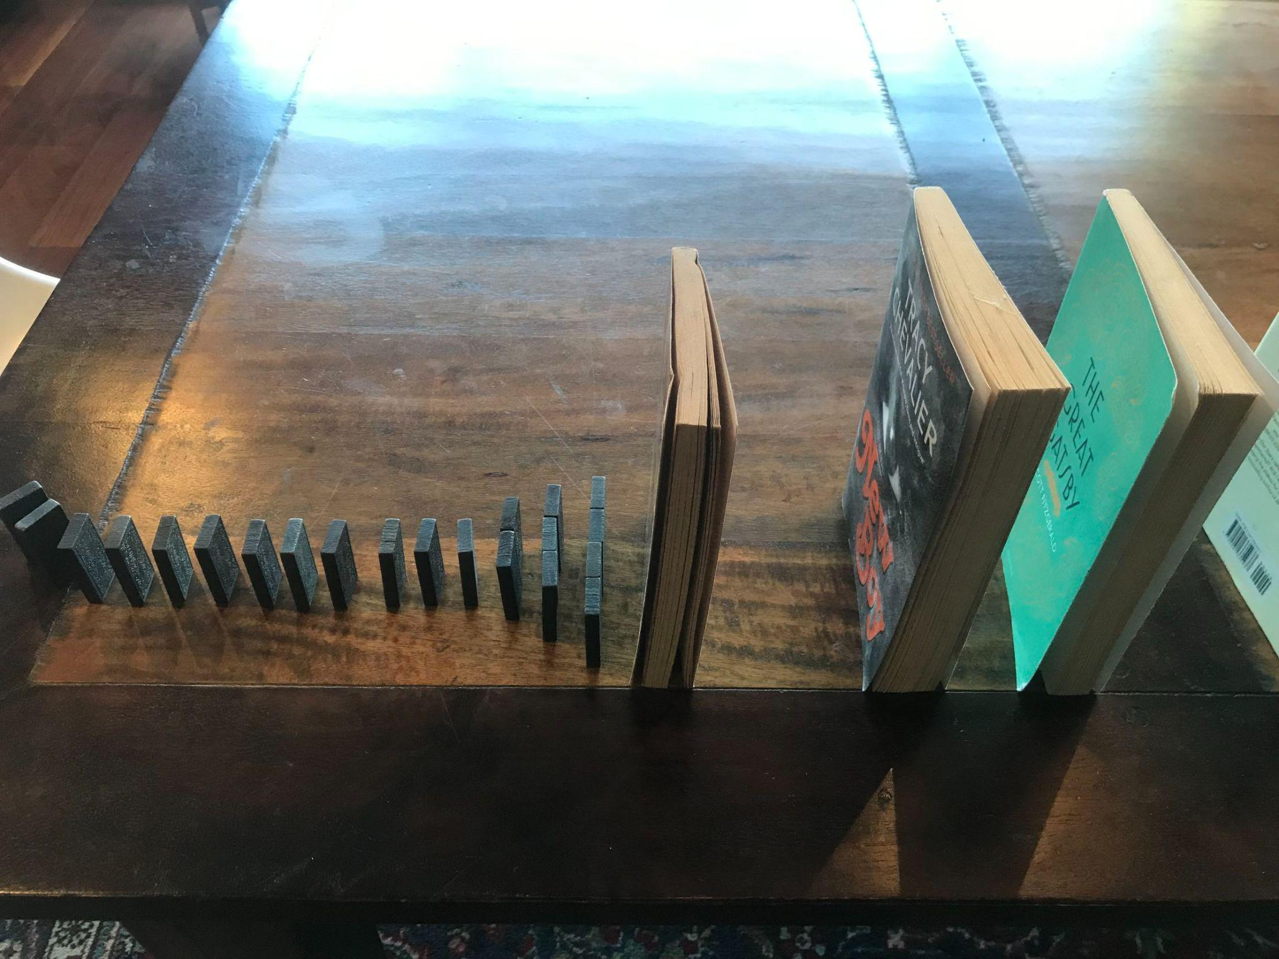
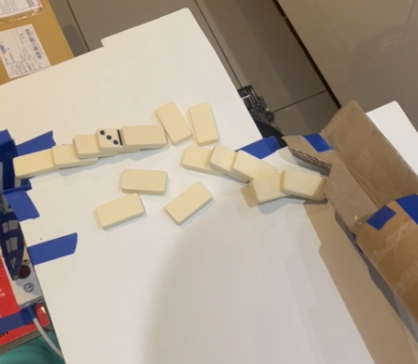
Domino Test

Slide 12
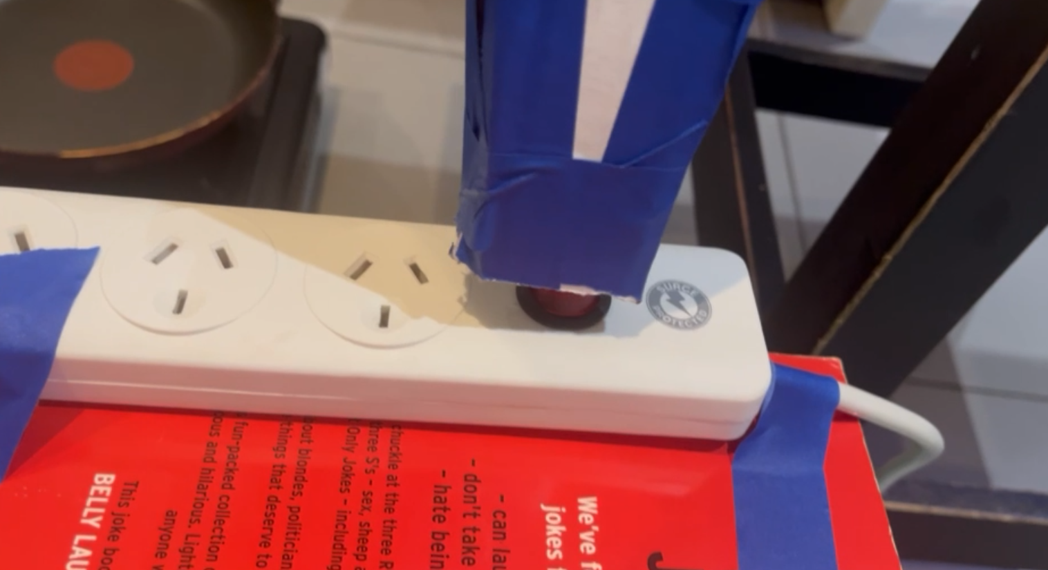
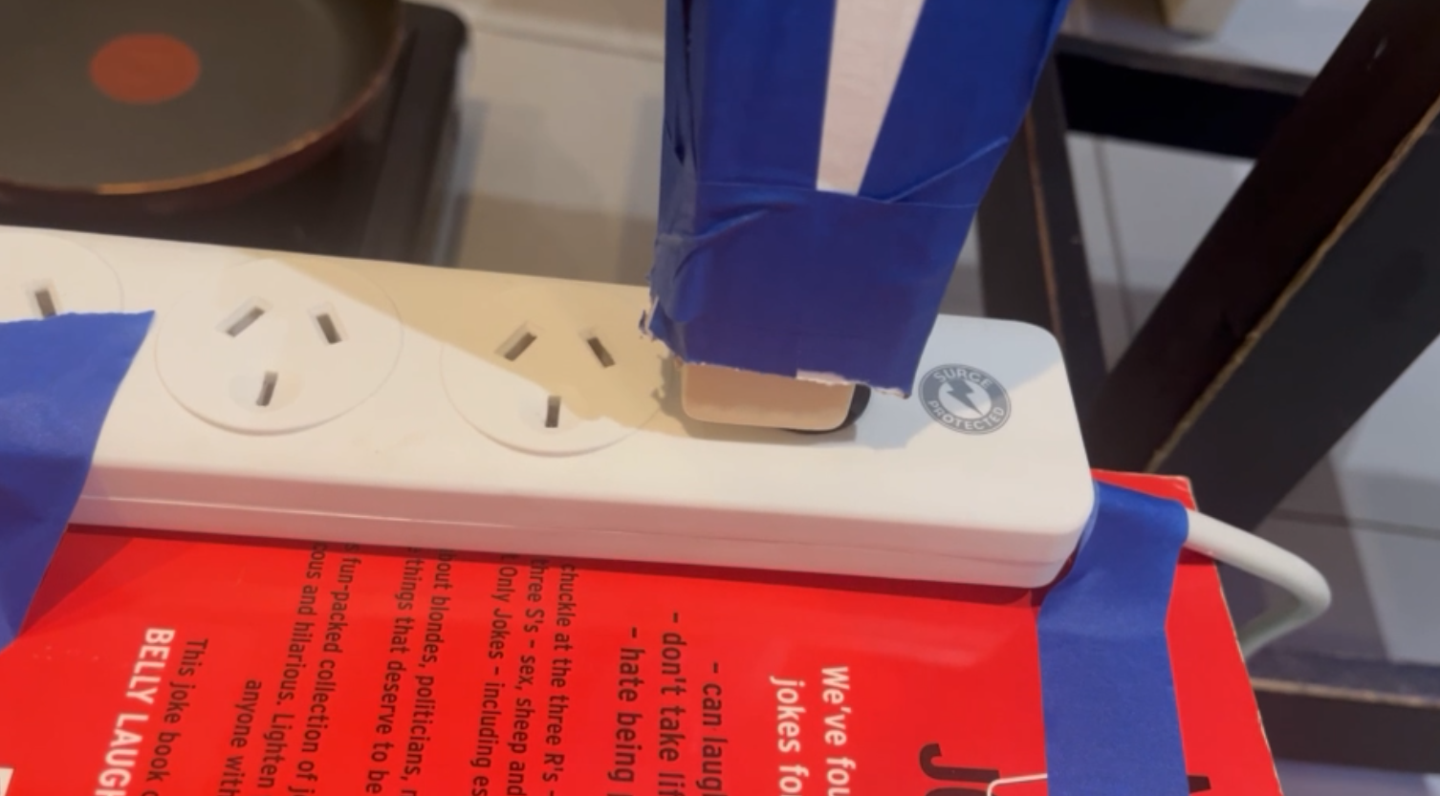
Fan Switch Test

Slide 13
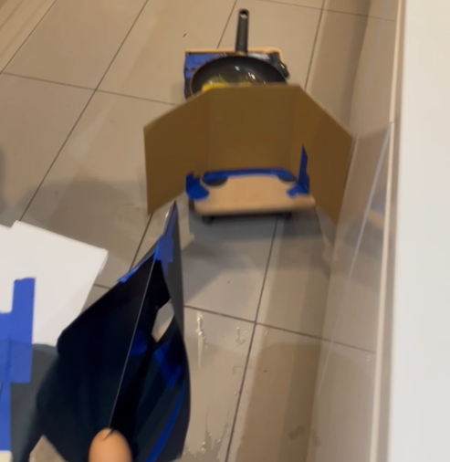
Wind Test

Slide 14
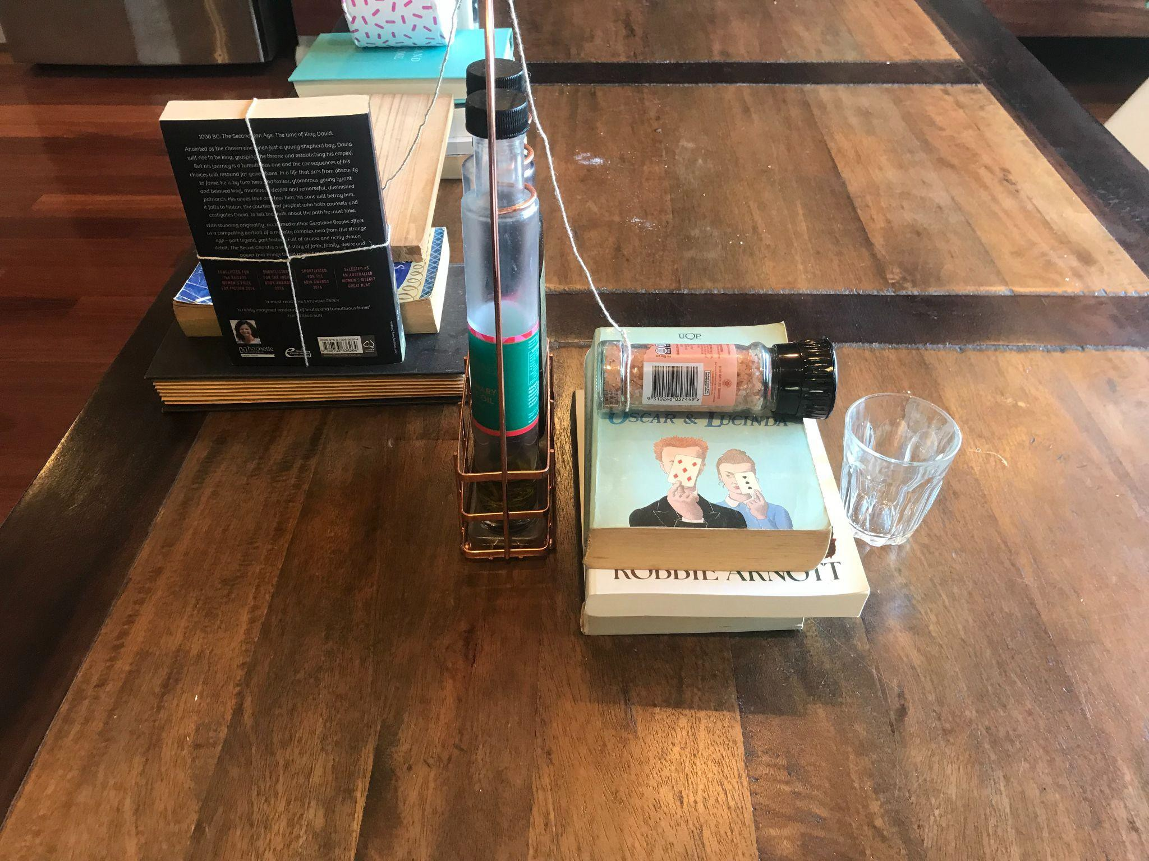
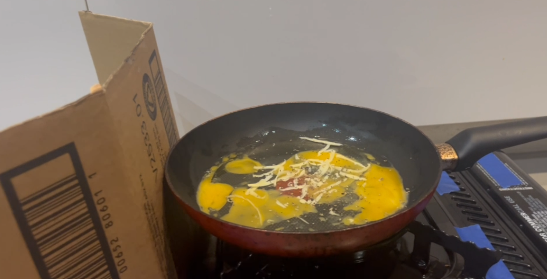
Ingredients Falling Test

Slide 15
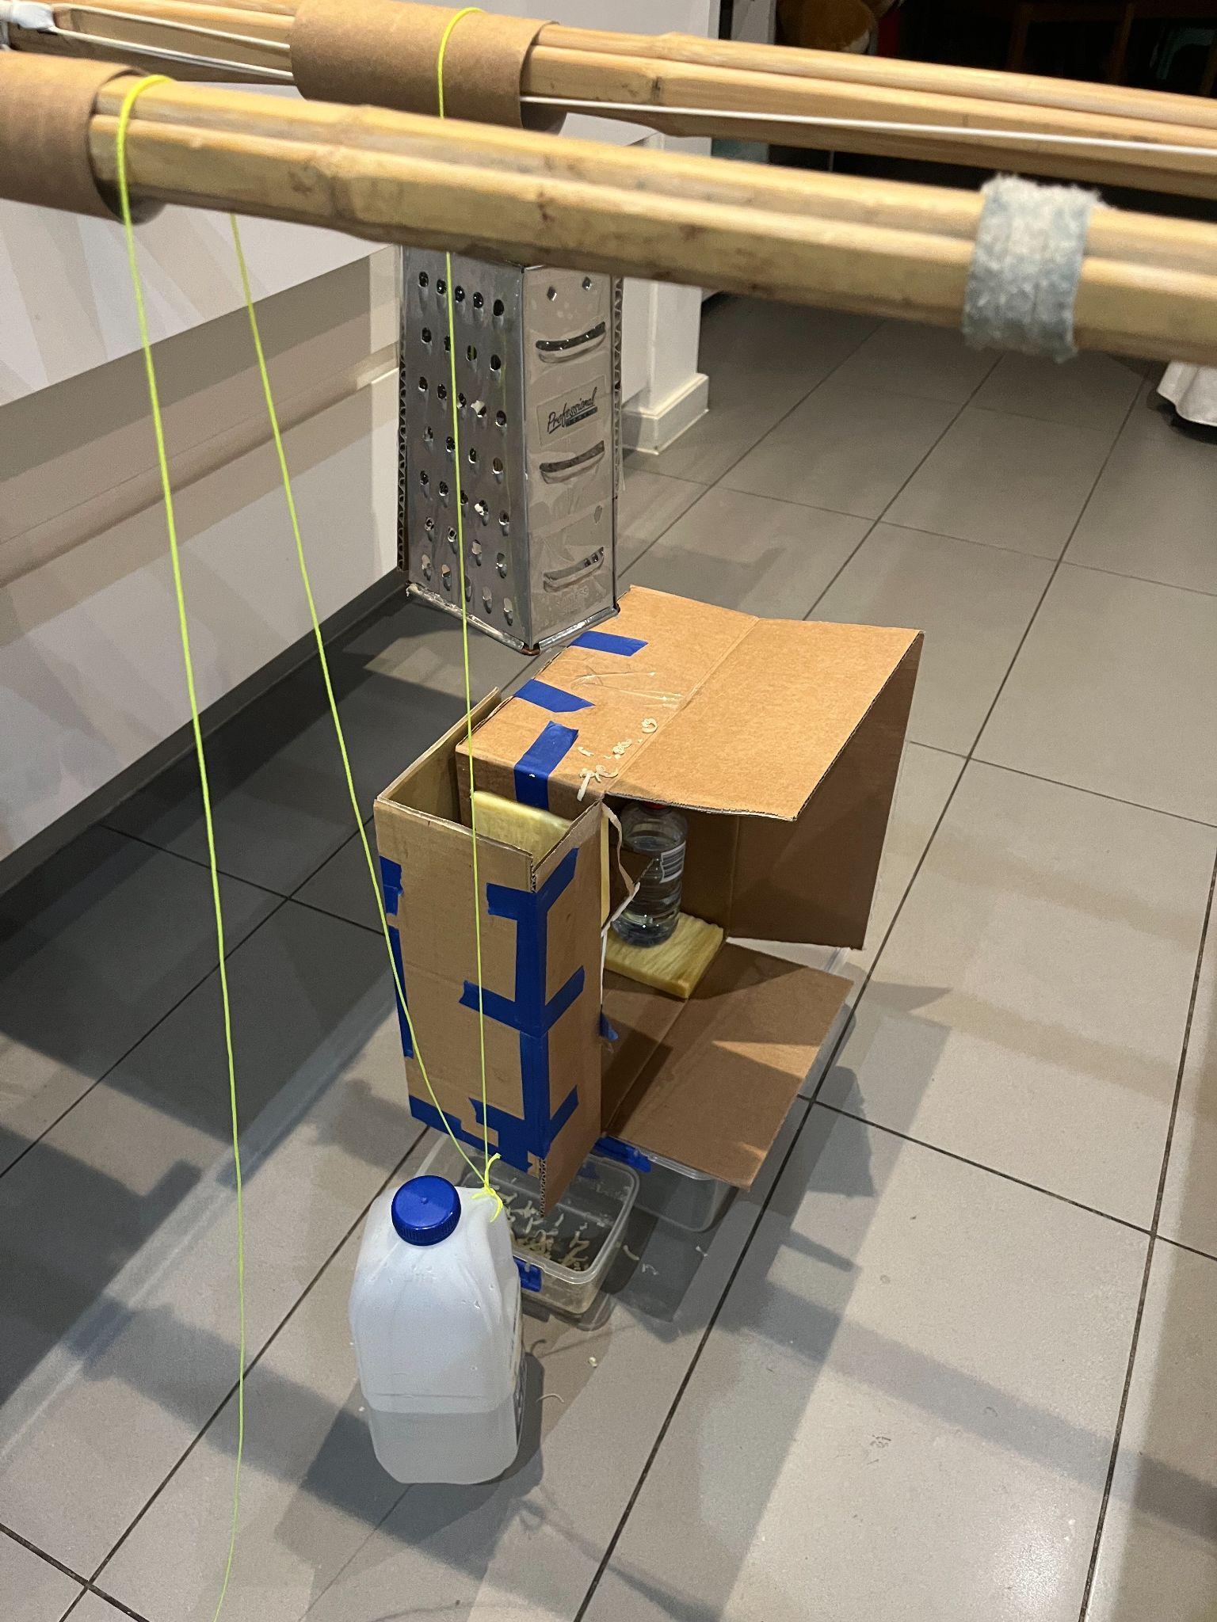
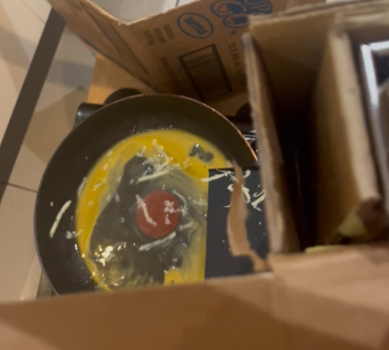
Cheese Grater Test

Slide 16
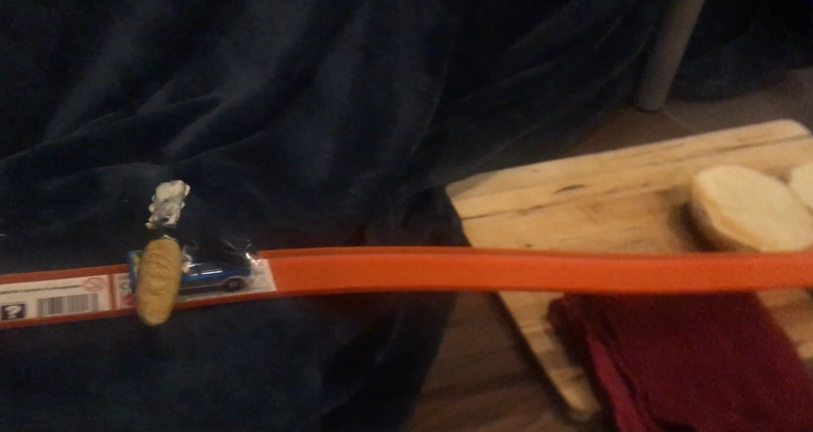
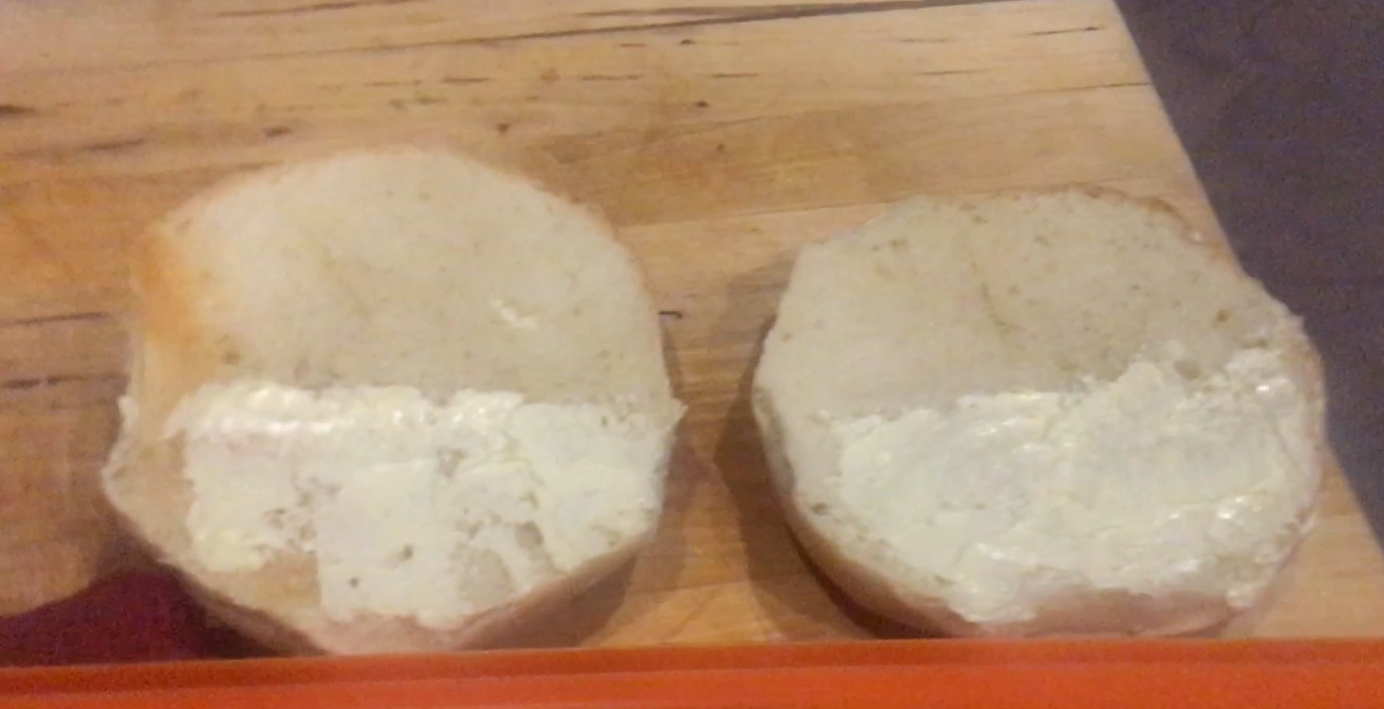
Butter Test

Slide 17

RGM Video

Slide 18
4. Reﬂection and Learning
William Dixon

Slide 19
Thank you for Listening

